Slide 1
Medical Readiness with MHS Genesis
Brought to you by: ACH Stuttgart

Slide 2
1. Access the MHS Genesis Patient Portal
https://my.mhsgenesis.health.mil/pages/home
Log in with DS Logon or CAC

Slide 3
2. Navigate to the Messaging tab
These tabs can be seen after logging into the Patient Portal.
Click on the Messaging tab.
Then, click on the “Send a message” button as shown above.

Slide 4
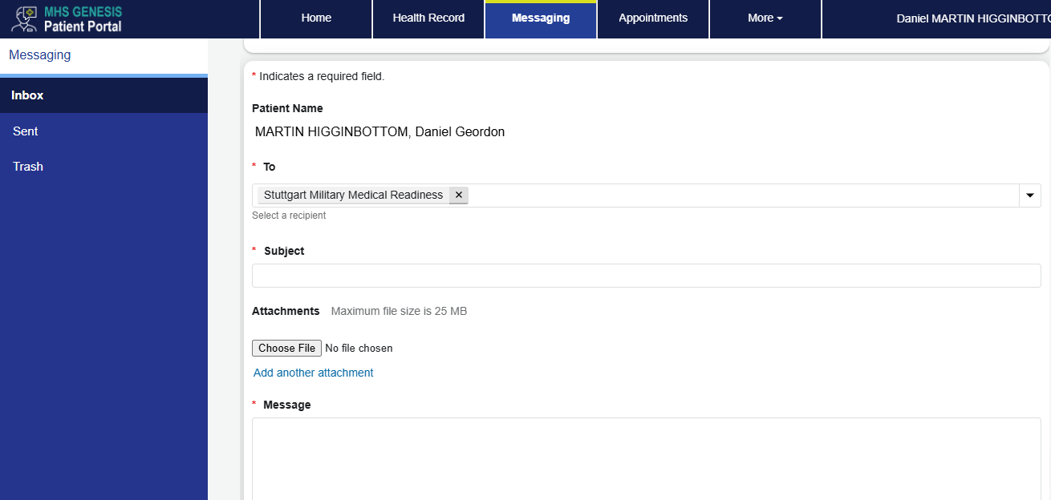
3. Compose the message and send
Send a message to “Stuttgart Military Medical Readiness”
In the message, please provide requested service(s), Service Branch, current status (Compo 1, 2, 3/Active, Guard, Reserve), and a good contact number/email for duty hours.

Slide 5
4. Wait for an answer/response
After sending the message to the Stuttgart Military Medical Readiness group, please allow up to 48-72 hours for an answer or a response to your message from the Medical Readiness Team.
The more descriptive you are with your message, the less change of delay due to asking for more information regarding your message.

